Slide 1
Azure Data Factory
In practice
Tomasz Krawczyk

Slide 2
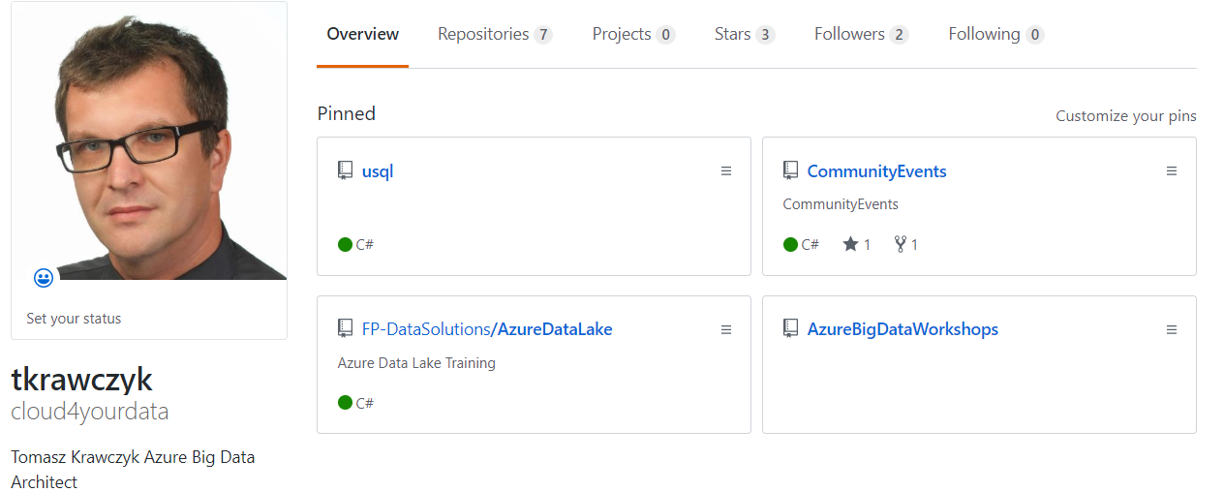


About Me
https://github.com/cloud4yourdata
{CommunityEvents}

Slide 3
Agenda
Our Project – quick overview
Azure Data Factory
Pipelines, Actions, Linked Services, Datasets
Project challenges and Azure Data Factory
Notes:
I my zeby tak gwaltownie niezaczac

Slide 4
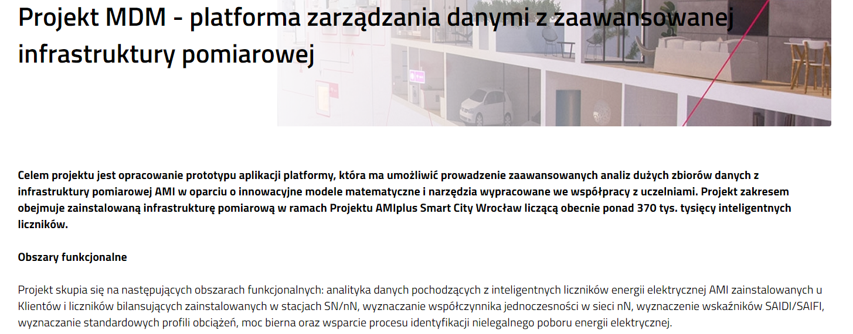
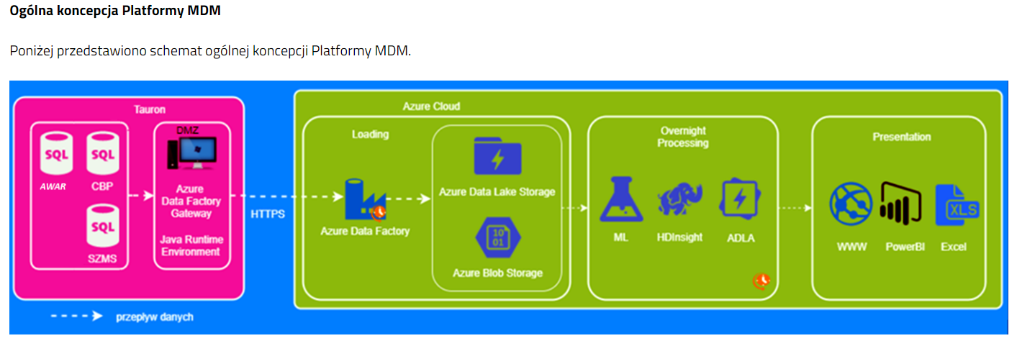
Big Data Project
https://www.tauron-dystrybucja.pl/o-spolce/innowacje-tauron/mdm
Notes:
I my zeby tak gwaltownie niezaczac

Slide 5
Big Data Project
Input Data
IoT (400 000 Meters)
Source OnPremise Oracle Database
30 TB Initial Load
15 GB Daily Load (Batch Mode)
Data Processing
7 problems = 7 algorithms
(Mathematical and analytical models )
Batch mode
Total Processing Time < 8h
Output data
KPIs
Visualizations (Maps, Charts…)
Access to raw data
Detailed Queries (Point Queries)

Slide 6
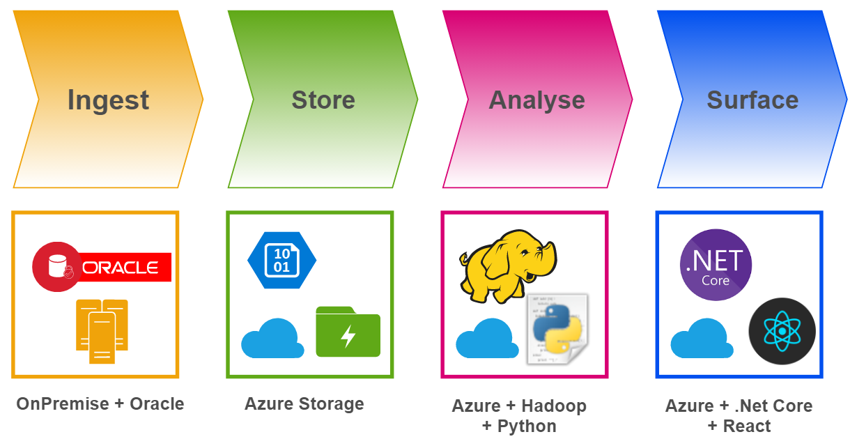
Big Data Project – Basic Concept
Notes:
Pierwszy pomysl na nasz project pokrywa sie z koncepcja przetwarzania oparta o Data Lake czy
Najpierw pobiaramy dane z bazy Oracle ze srodowiska lokalnego, dane te zapisujemy w chmurze w naszym przypadku to chmura Azure
, nastepnie jakism narzedziami z ekosystemu Hadoop, ktorych jest calkiem sporo oraz wykorzystaniem jezyka Python budujemy procesy przetwarzania danych danych.
Dane dla uzytownika koncwego beda dostepe za pomoca dedykowanej aplkacji stworzonej o oparciu o .Net Core (backend system) oraz React

Slide 7

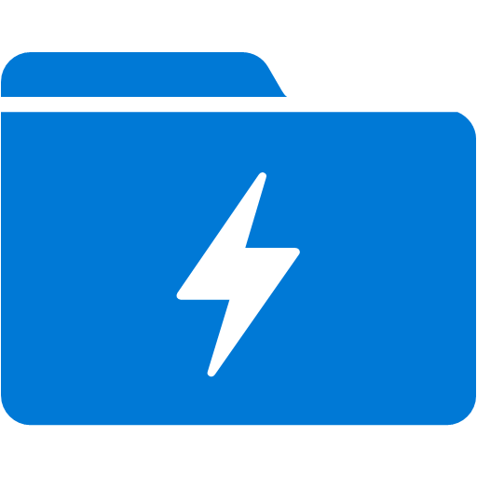
First Challenge
Loading Data - Ingest
Oracle
Azure Blob Storage
Incremental Load
Azure Data Lake Storage (Gen1)
Azure Data Lake Storage (Gen2)

Slide 8
Data Integration
SSIS –SQL Server Integration Services
Part of SQL Server
ETL to/from SQL Server/Data Warehouse
Rich designer (and other tools e.g. BIML)
Azure Feature Pack for Integration Services
Azure Data Factory

Slide 9
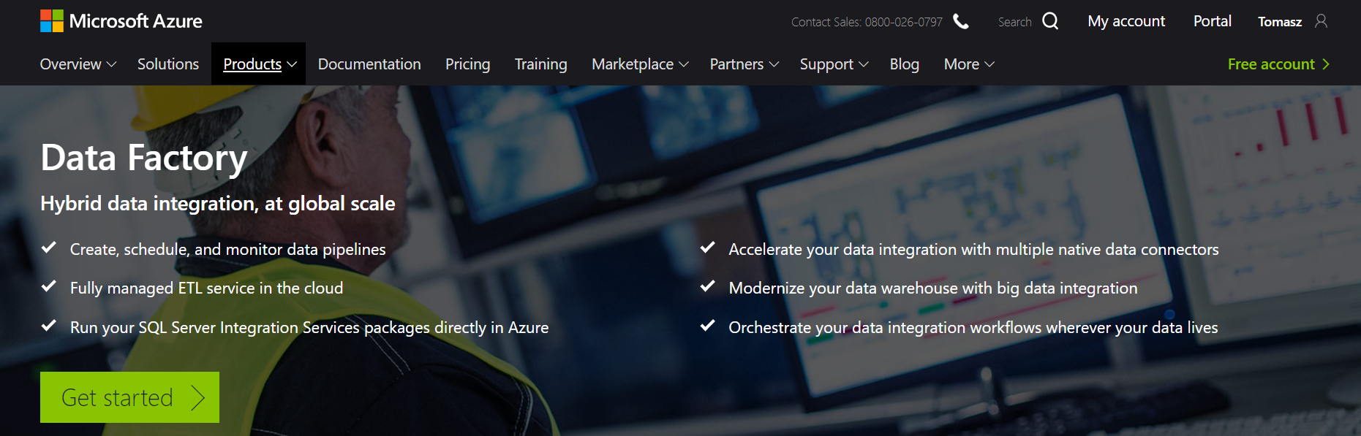
Azure Data Factory (V2)
https://azure.microsoft.com/en-us/services/data-factory/
Notes:
Fully managed service to support orchestration of data movement and transformation
Connect to relational or non-relational data that is on-premises or in the cloud
Allows monitor and manage data processing pipelines
Version 1 and 2 (+SSIS)

Slide 10
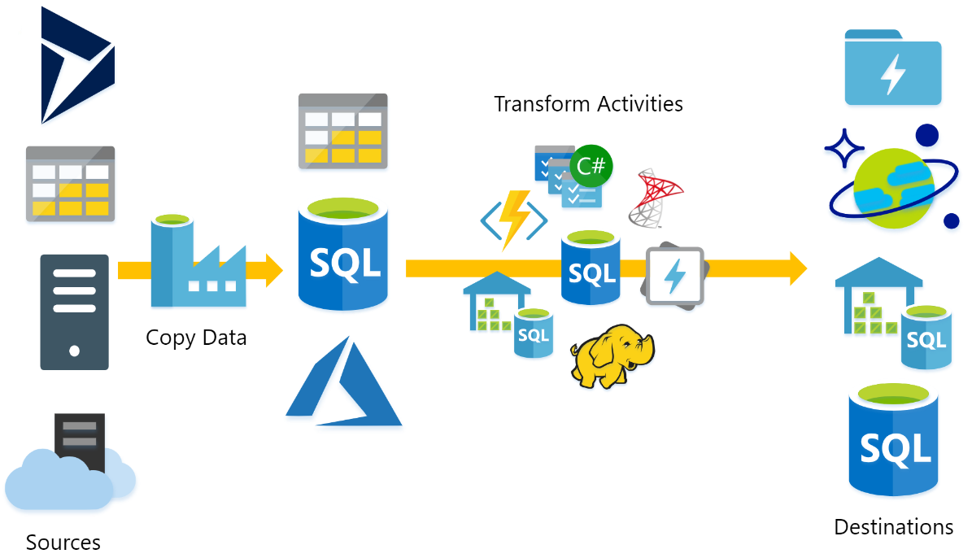
What does ADF do?
Source : P.Andrew

Slide 11

Azure Data Factory Concept
Dataset
(eg. tables, files)
Activity
(eg. Copy, Hive job,
SP, ADLA job)
Pipeline
(schedule,monitor,
manage)
Consumes
Is a
logical
grouping of
Produces
Represents
data item(s)
stored in
Runs on
Linked Services
(eg. SQL Server,
HDInsight,ADLA)
Triggers
Notes:
Activities
Actions you perform on your data
Inputs turned into outputs
Pipelines
Logical grouping of activities for group operations
Data sets
A named reference/pointer to data you want to use as an input or output of an activity
Linked services
Connection of data factories to the resources and services you want to use
Connection of data stores like Azure storage and on-premises SQL Server
Connection of compute services like Azure Machine Learning, Azure HDInsight, and Azure Batch

Slide 12
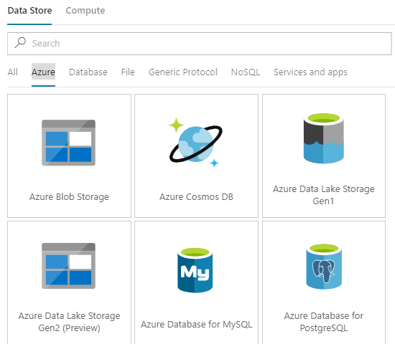
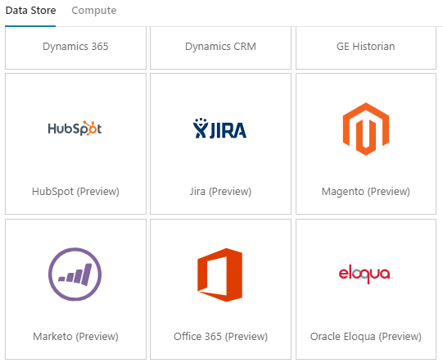
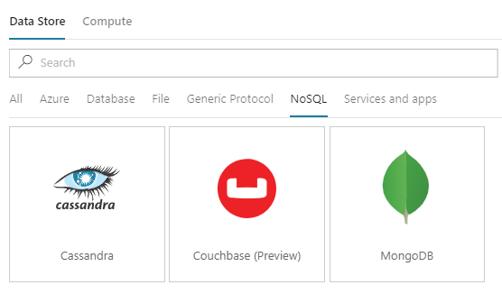
Azure Data Factory – Linked Services
More than 70 connectors

Slide 13
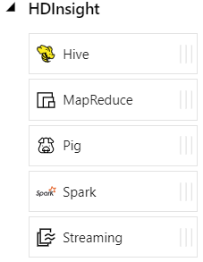
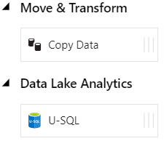
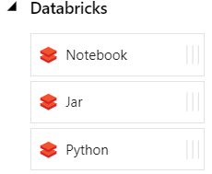
Azure Data Factory - Data activities
Data movement activities : Copy Activity
Data transformation activities :
HDInsight (Hive, Pig, MapReduce ,Hadoop Streaming ,Spark)
Azure Databricks Notebooks, Jars, Pythons
Machine Learning activities: Batch Execution and Update Resource (*)
Stored Procedure
Data Lake Analytics U-SQL
DotNet (Custom)

Slide 14
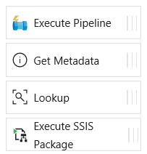
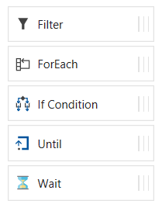
Azure Data Factory - Control flow activities
Execute Pipeline Activity
ForEach Activity
Web Activity
Lookup Activity
Get Metadata Activity
Until Activity
If Condition Activity
Wait Activity

Slide 15
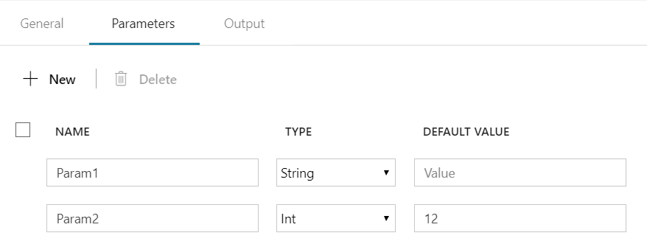
Azure Data Factory – Parameters
Parameters - are key-value pairs of read-only configuration settings that are defined in pipelines
Name, Type, Default Value
@pipeline().parameters.Param1
@pipeline().parameters.Param1

Slide 16
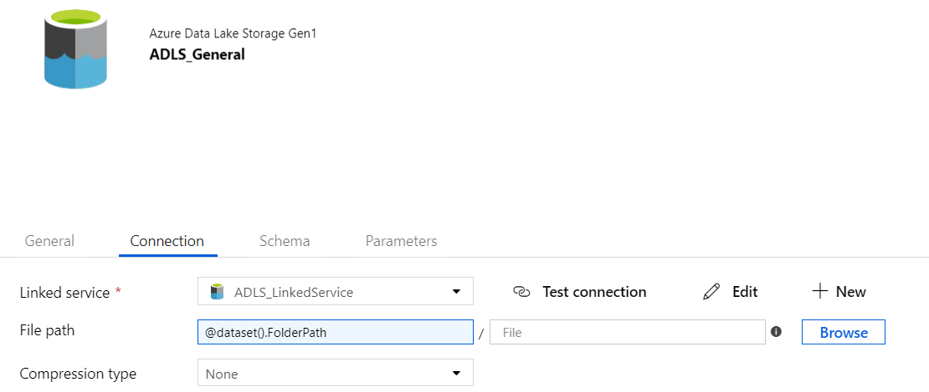
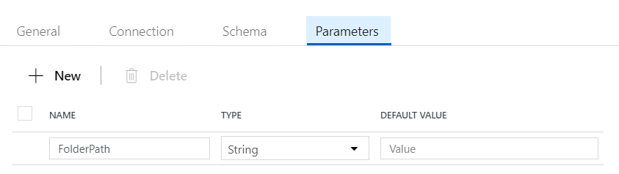
Azure Data Factory – Datasets Parameters

Slide 17
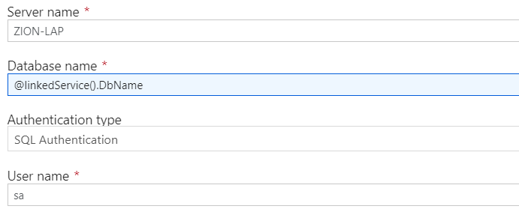
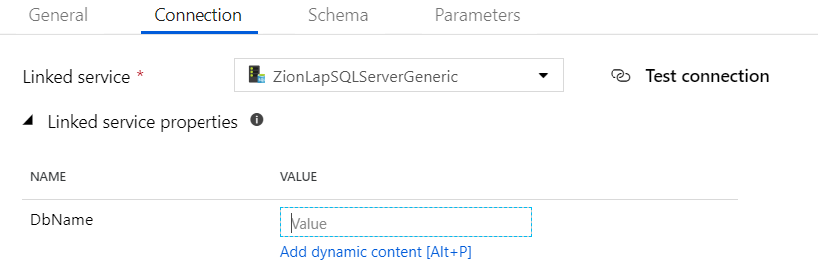
ADF – Linked Services Parameters

Slide 18
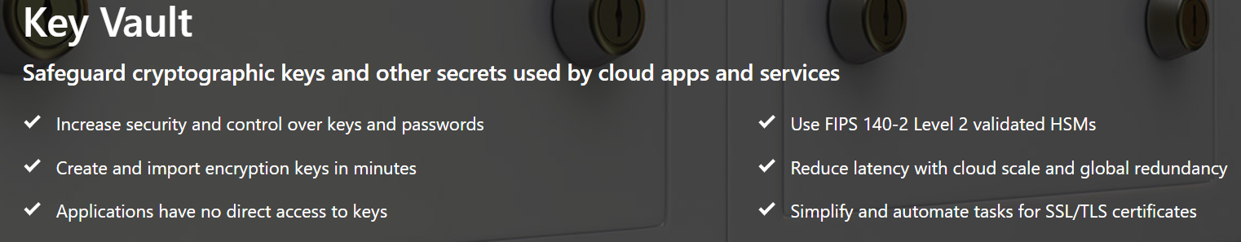
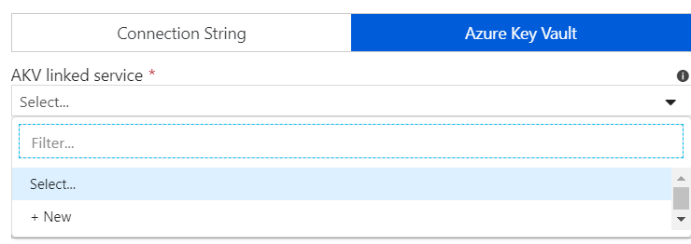

ADF – Linked Services Azure Key Vault

Slide 19
ADF – Variables
Pipeline scope (System):
@pipeline().DataFactory
@pipeline().Pipeline
@pipeline().RunId
@pipeline().TriggerType
@pipeline().TriggerId
Trigger scope(System):
@trigger().scheduledTime
@trigger().startTime
User pipeline scope Variables
Set Variable Activity
Append Variable Activity

Slide 20
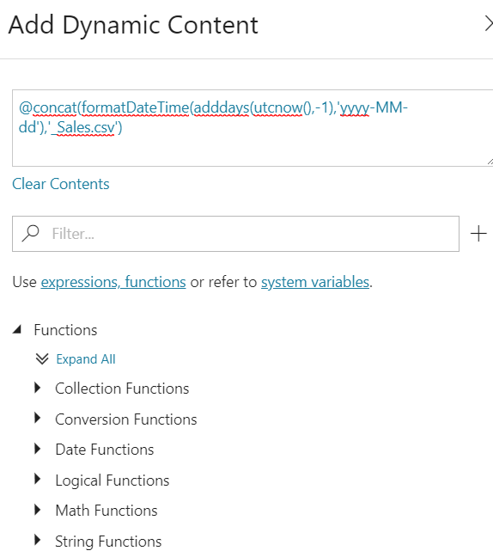
ADF – Expressions and Functions
Expressions
Dynamic Content
Functions
String functions
Collection functions
Logical functions
Conversion functions
Math functions
Date functions

Slide 21
ADF– Branching
Branching
On success
On failure
On completion
Activity 2
On success
Activity 1
(eg. Copy, Hive job,
SP, ADLA job)
Activity 3
On completion
On failure
Activity 4

Slide 22
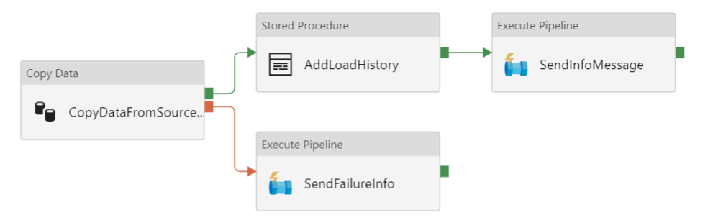
ADF –Branching

Slide 23
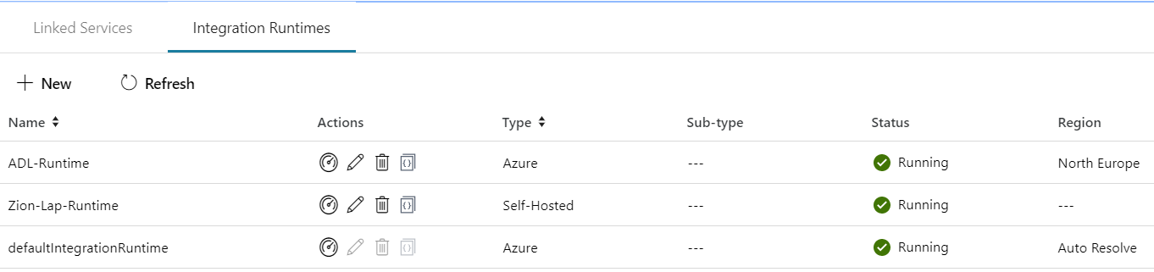
Integration runtime(s) in Azure Data Factory
The Integration Runtime (IR) is the compute infrastructure used by Azure Data Factory to provide the following data integration capabilities across different network environments
Integration runtime types:
Azure (Data movement and activity on Azure)
Self-hosted (Data movement and activity dispatch between public and private network)
Azure-SSIS (SSIS package execution)

Slide 24


Self Hosted Integration runtime
Now called Self Hosted Integration Runtime
Before Data Management Gateway
One version for ADF V1 and V2
SSL Port : 443
One to Many

Slide 25
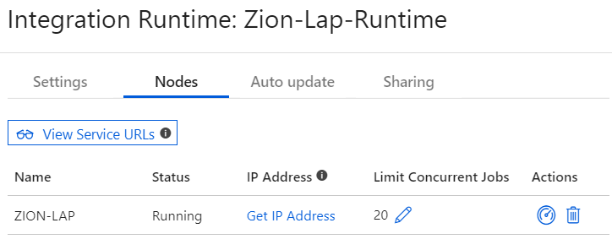
Self Hosted Integration runtime

Slide 26
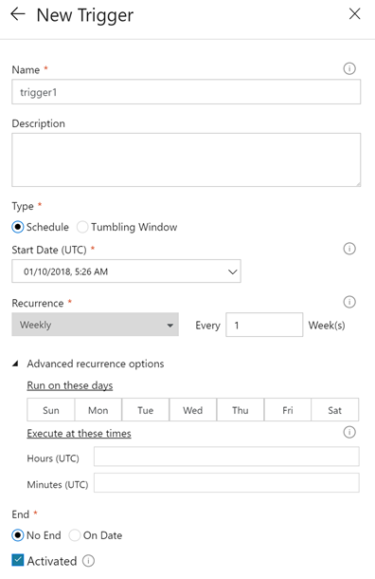
Pipeline execution and triggers in Azure Data Factory
Manual execution (on-demand)
The REST API
The .NET SDK
Trigger execution
Schedule trigger
Tumbling window trigger

Slide 27
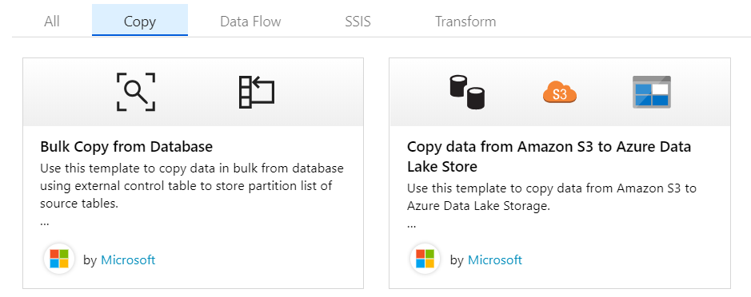
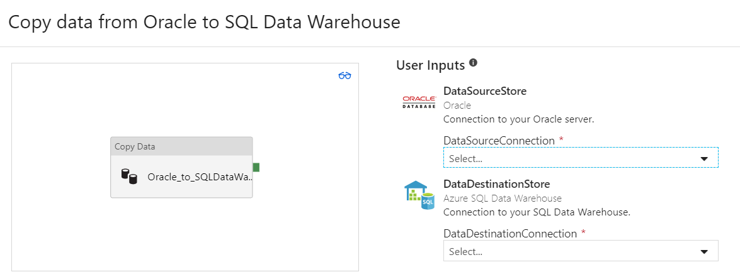
ADF -Templates

Slide 28
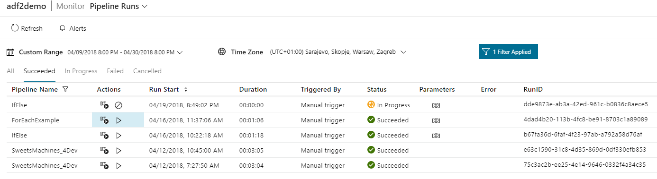
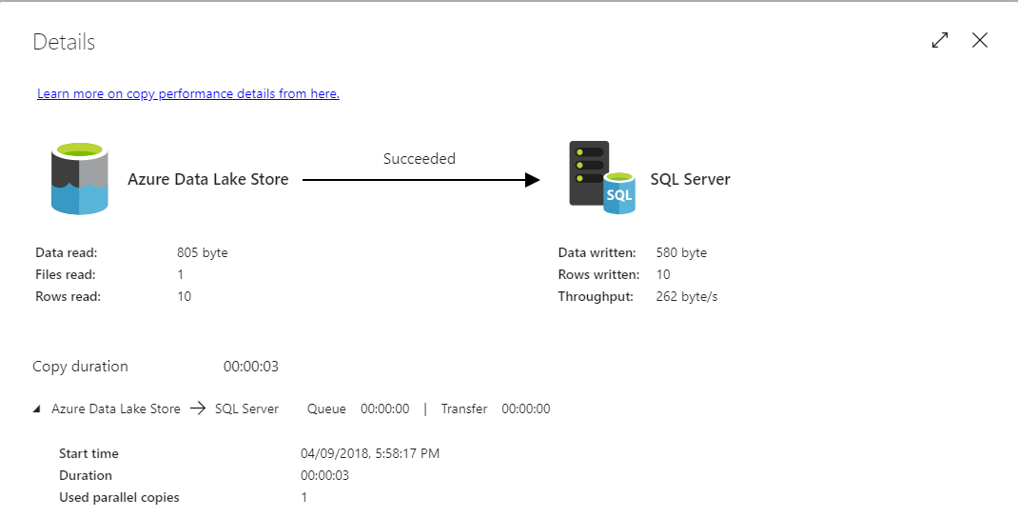
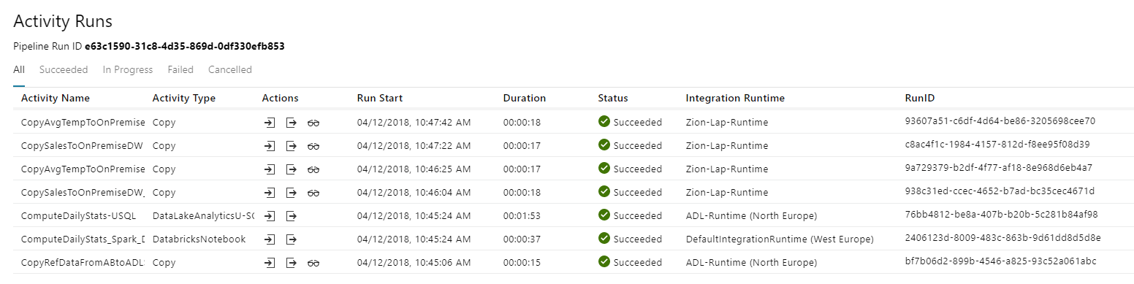
Azure Data Factory Monitoring

Slide 29
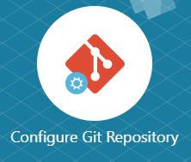
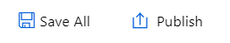
Azure Data Factory Source Control
Visual Studio Team Services (Azure Portal)
Import/Export ARM Templates
GitHub

Slide 30
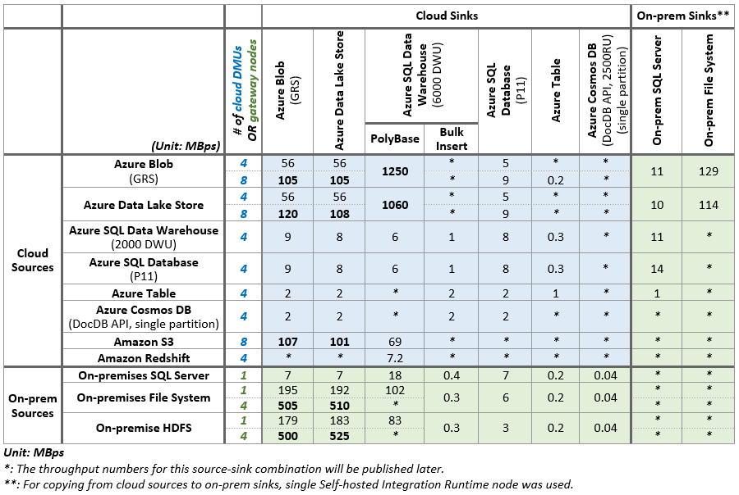
Azure Data Factory Performance
https://docs.microsoft.com/en-us/azure/data-factory/copy-activity-performance

Slide 31
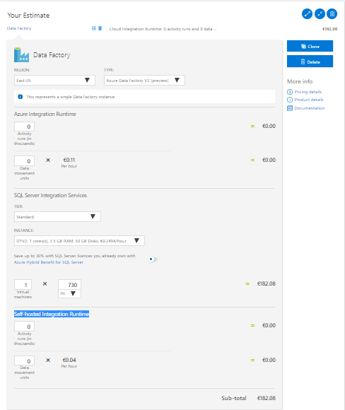
Azure Data Factory Costs
Costs depend on Integration Runtime:
Azure Integration Runtime
Activity runs (in thousands)
Data movement units
Self-hosted Integration Runtime
Activity runs (in thousands)
Data movement units
SQL Server Integration Services
Virtual machine(s) type e.g. D1V2 (h)
https://azure.microsoft.com/en-gb/pricing/calculator/

Slide 32
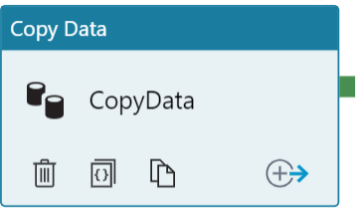


Loading Data - Ingest
SQL Query
CSV File
ADF Self-hosted IR
Azure Data Factory
Copy Activity
Azure Data Lake
Store
Challenges
More than 100 Queries
Incremental Load

Slide 33
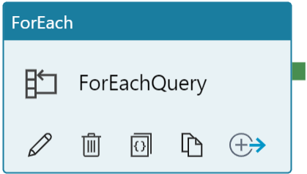

Loading Data - Ingest
SQL Query
CSV File
Self-hosted IR
Azure Data Factory
Copy Activity
Azure Data Lake
Store
20 DOP
Query = Where (Inserted Date Between Last Load and Now)

Slide 34
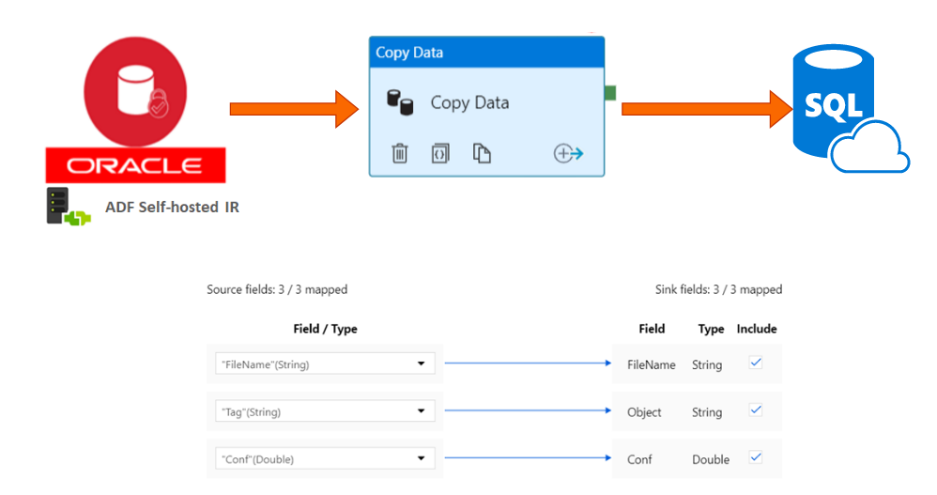
Loading Data - Ingest
Port:1433

Slide 35
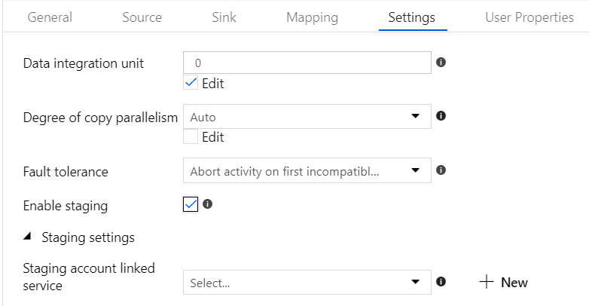
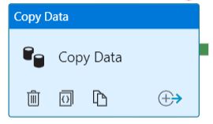
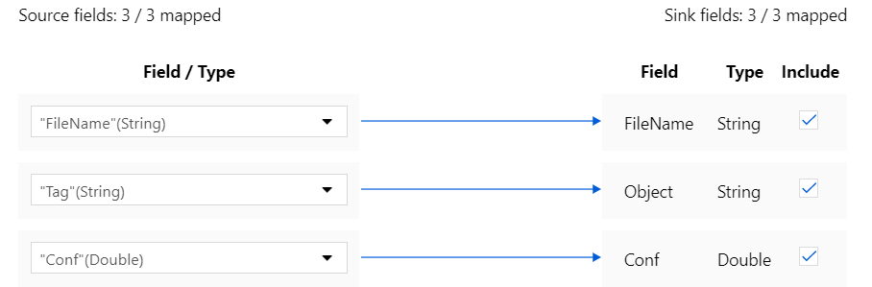
Azure Data Factory – Copy Activity

Slide 36
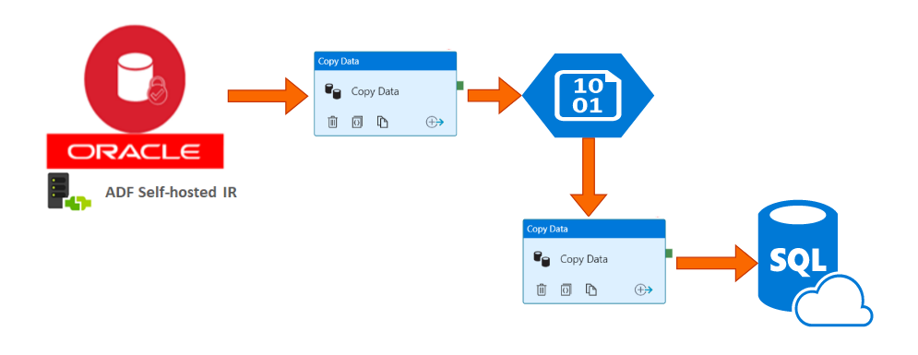
Azure Data Factory – Copy Activity
ADF (2 runtimes Self Hosted and Azure)

Slide 37




Data Processing - Analyse
OR
Azure HDInsight
Azure Databricks
AND
Azure Data Lake Analytics
Notes:
Jesli chodzi o analize danych to założylismy ze bedziemy uzywac zarowno Sparka (ktory jest najbardziej popularnym frameworkiem do przetwarzania duzych zbiorow danych)
jak I azure data lake analyctis
Spark na platformie azure jest dostepny jako jedna z uslug dostepnych w ramach Azure Hdinsight oraz Azure Databricks
(Na obecnym etapie naszego projektu nie zdecydowalismy jeszcze czego bedziemy uzwac jesli chodzi o Spark

Slide 38
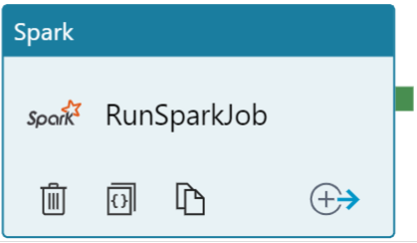
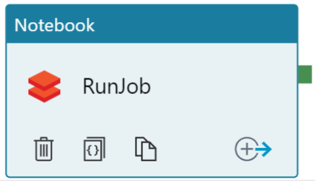
Data Processing - Analyse
~ 15 - 25 minutes
Azure HDInsight
Create Cluster on demand, run job and terminate cluster
~ 10 -20 minutes
Azure Databricks

Slide 39
DEMO(s)

Slide 40
Q & A

Slide 41
Resources
https://github.com/cloud4yourdata
https://github.com/FP-DataSolutions

Slide 42
THANK YOU!

